Slide 1







Investigations Of Moisture Partitioning Between Arizona And New Mexico During The North American Monsoon And The Role Of The Ocean And The Sea Surface Temperatures
Cynthia Kobold
Department of Applied Aviation Sciences
Embry-Riddle Aeronautical University, Prescott, Arizona

Slide 2
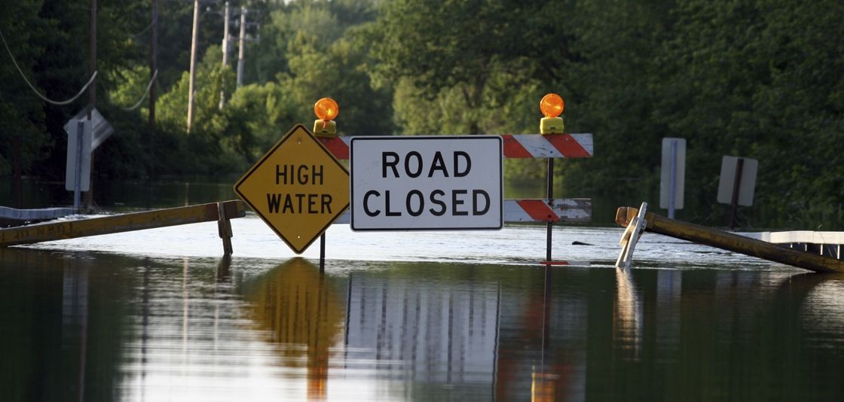
Motivation
Effects of flooding:
  Loss of life
  Loss of property
  Environmental Hazards
September 2014 Southwest Monsoon:
  9 fatalities
  $25 million in damages reported
Photo credit: National Oceanic and Atmospheric Administration

Slide 3
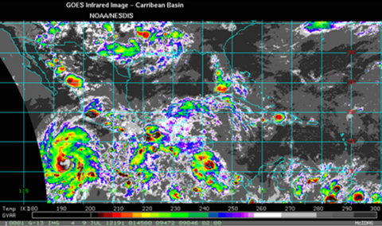
Research Objectives
While recent studies have linked strong North American (NA) monsoons to summer drought in the United States Midwest, the sequence of events which produce the NA monsoon remains unclear. It is important to show how the NA monsoon may operate in two modes: one producing anomalously wet conditions in New Mexico (but not Arizona), the other mode producing wet conditions in Arizona (but not New Mexico). Before mechanistically understanding any possible linkage between the NA monsoon and midwestern precipitation patterns, we need to understand the processes responsible for these two apparent modes.
Tropical easterly wave on 8 July 2002 may be responsible for moisture surge up the gulf axes which was apparently enriched by northern gulf moisture.

Slide 4
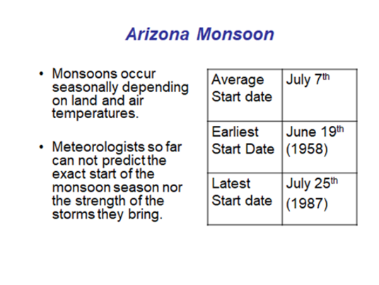
Monsoon Modes
The question can be asked, “are wet monsoon seasons for AZ also wet for NM and vice versa?” We show that in wet AZ years, wet conditions are extensive throughout the southwest, extending into Utah, Nevada and California, while eastern NM is drier than normal. We suggest that the dominant moisture source for wet AZ monsoon seasons is the Gulf of California (GC).
Arizona monsoon facts: onset, earliest start date, latest start date.

Slide 5
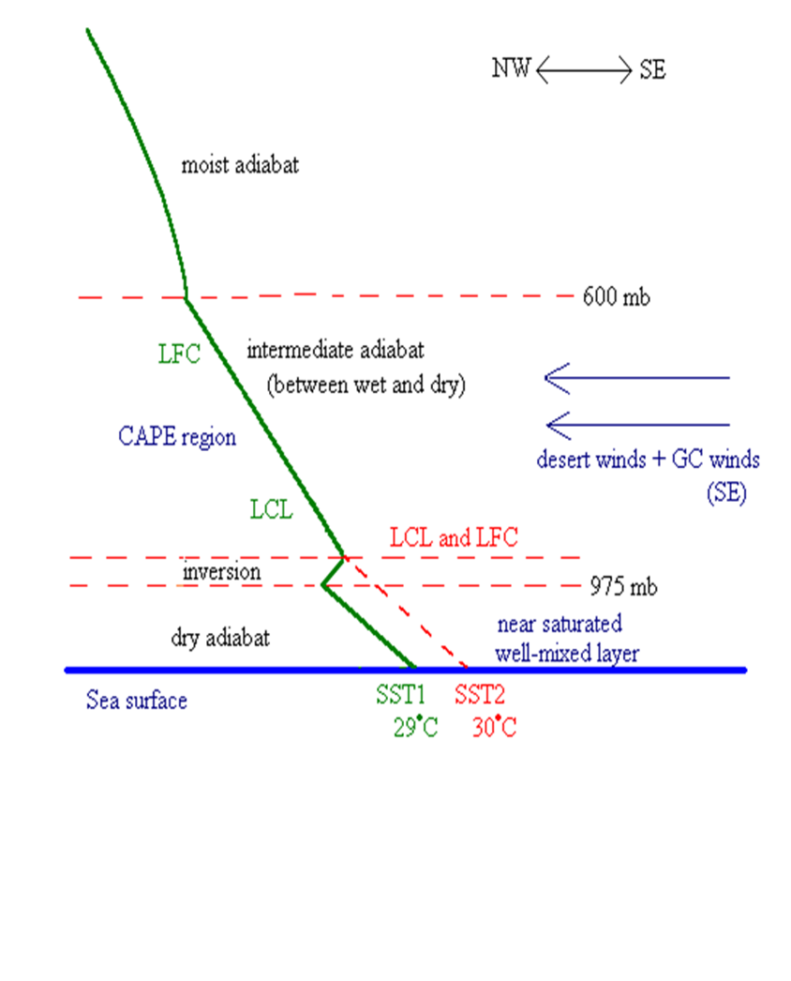
Hypothesis
An inversion may result from the contrast between desert and the Marine Boundary Layer (MBL) air temperatures.
We have labeled the region between 600 mb and 975 mb as the “CAPE region” since the lower the LFC is in this region, the greater the CAPE is. This type of sounding appears consistent with those observed over the GC during surge events.
Conceptual Model of Moisture Advection Dependence on SST.

Slide 6
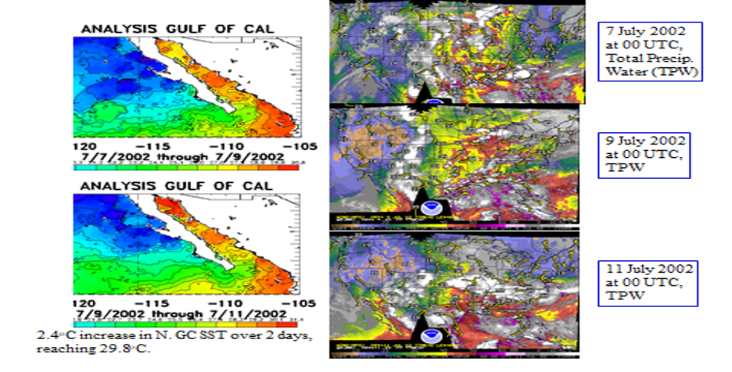
Analysis: SSTs & TPW
Sea Surface Temperatures (SST) and Tropospheric Precipitable Water (TPW).

Slide 7
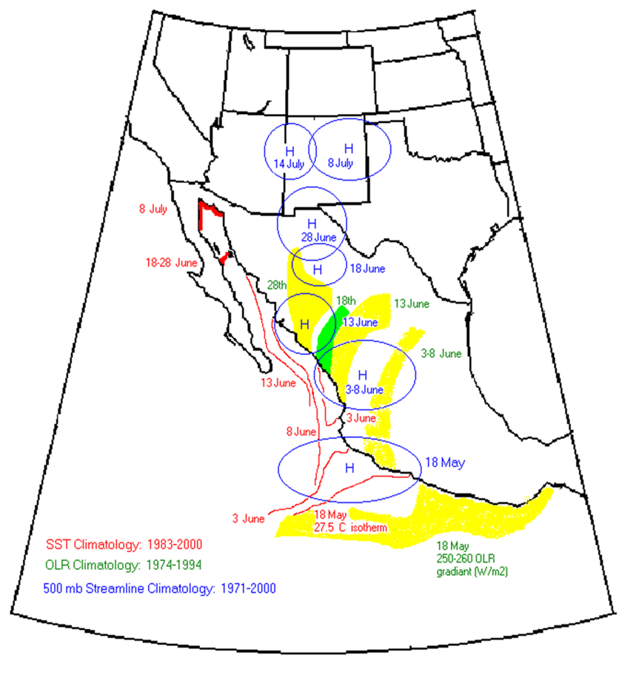
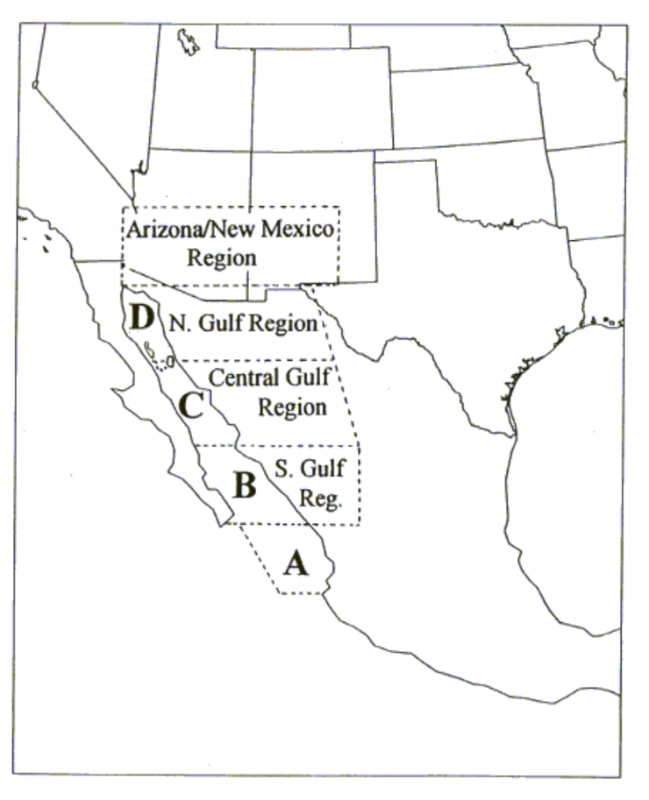
Gulf of California
Evolution of the 27.5°C isotherm, the 500 mb anticyclone center, and the 250-260 W/m^2 OLR gradient (transition between regions of rising and descending air).
The Gulf of Baja-California and its 4 regions.

Slide 8
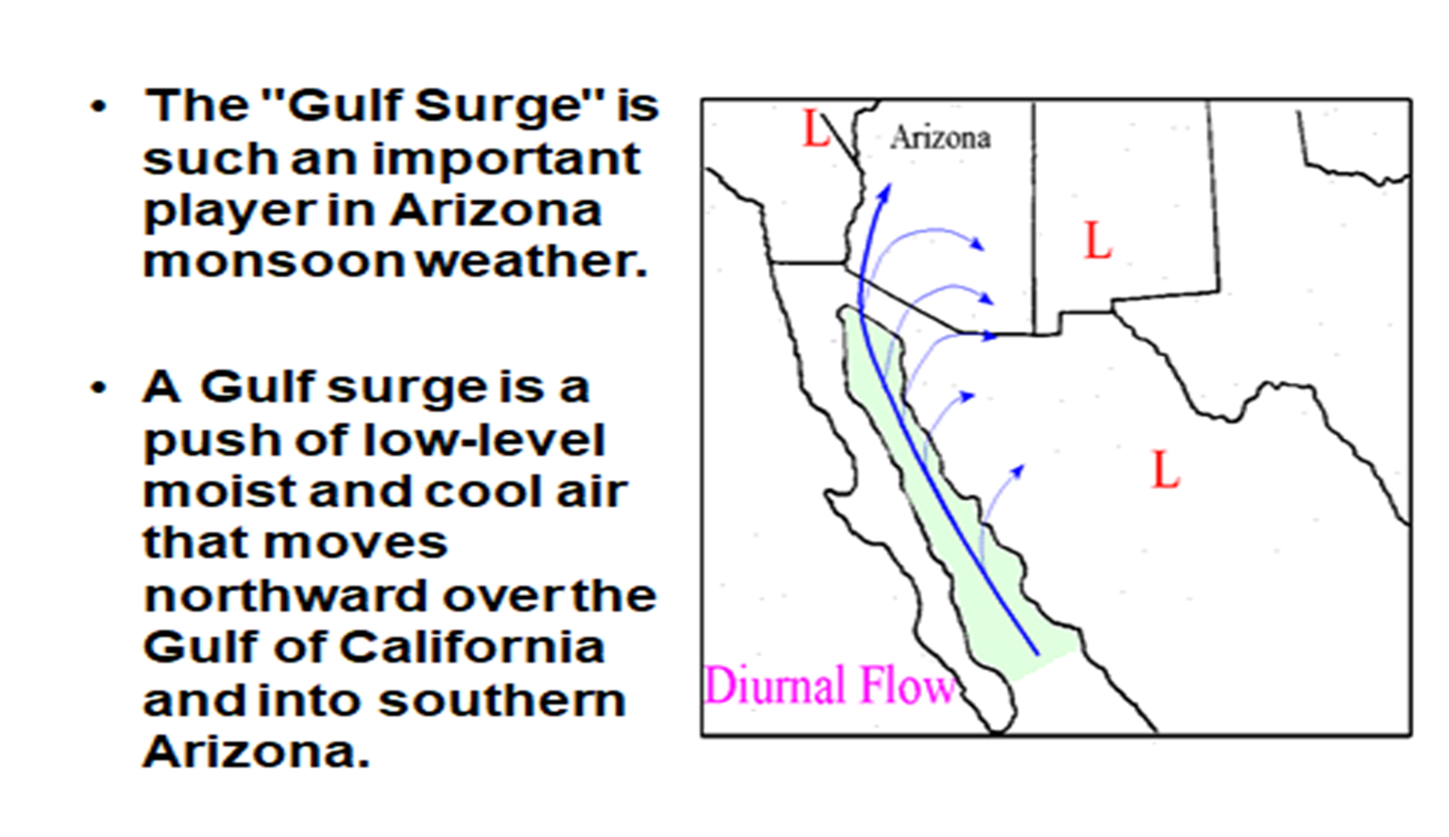
Gulf Surges

Slide 9
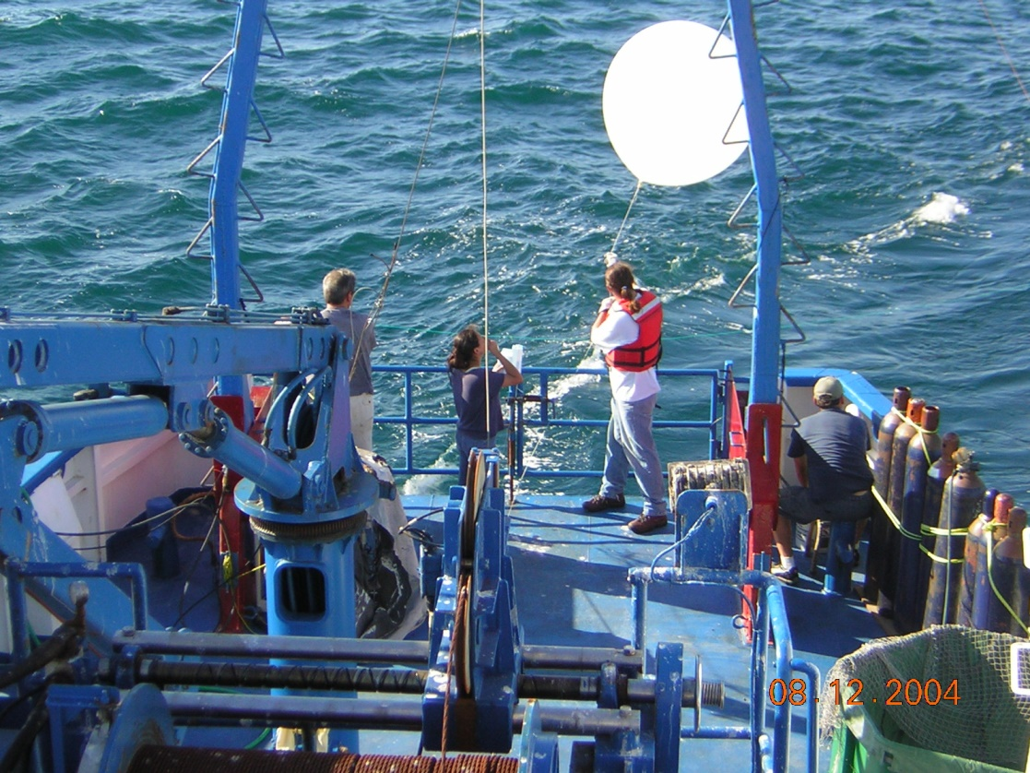
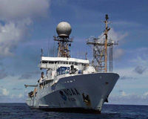

North American Monsoon Experiment (NAME) Science Cruises in the Sea of Cortez, Gulf of Baja-California, radiosondes / weather balloon launches, drifter buoys, ocean currents and sea surface temperatures, meteorological and oceanographic measurements.
Co-PI, NOAA funded research:
The role of oceanic processes on the
Gulf of California SST evolution during
the North American Monsoon Experiment (NAME)
Preparing the weather balloon for launch on the ship

Slide 10
Is the low-level inversion present when the SSTs are less than 29.5ºC and if it is how often do we observe it during our IOPs (Intensive observational periods)?
Answer: In 92% of all observations during both NAME
cruise IOPs the inversion was present when SSTs
were equal to or less than 29.5°C and eroded as soon
as SSTs exceeded this threshold.

Slide 11
Arizona Climatology
Deviation from normal Jul-Sep precipitation based on 9 wettest AZ seasons, relative to the long-term mean from 1950-95. In wet AZ years, wet conditions are extensive throughout the southwest, extending into Utah, Nevada and California, while eastern NM is slightly drier than normal.

Slide 12
New Mexico Climatology
Same as before, but for 6 wettest NM seasons from 1950 - 1995.
In wet NM years, AZ is near normal for the monsoon season, and wet conditions are confined to NM and parts of Colorado and Texas. Hence, a strong monsoon year for NM will generally not benefit other parts of the desert southwest.

Slide 13
Conclusions
This study suggests that the marine boundary layer (MBL) in the Gulf of California (GC) may be sensitive to GC SSTs. This MBL may act as a moisture source for monsoon rainfall over AZ.
The moisture source for the monsoon thundershowers affecting AZ, the Great Basin and Colorado appears to be the GC. Based on our previous work, we suggested that the dominant moisture source for wet AZ monsoon seasons is the N. Gulf of California, while this moisture source does not appear likely for wet NM seasons.
Observations of SST, TPW, winds and rainfall during the examined years appear consistent with the hypothesis developed.
The monsoon begins in western NM about a week earlier on average than in western AZ. If the NM monsoon moisture comes from the Pacific (which various satellite imagery suggest), it apparently comes from lower regions of the GC or the eastern Pacific near Acapulco, Mexico. In these regions, SSTs warm earlier than in the N. GC, and may explain the earlier onset times in NM.

Slide 14
Acknowledgments
I would like to thank Dr. Ivanova for being my research advisor, mentor and meteorology professor.
Thank you to the NASA Space Grant program at Embry-Riddle for funding this research opportunity.

Slide 15
References
(2016, March 17). Retrieved March 27, 2018, from http://www.noaa.gov/media-release/spring-outlook-moderate-flood-risk-for-drenched-louisiana-east-texas
Mitchell, D. L., Ivanova, D., Rabin, R., Brown, T. J., & Redmond, K. (2002). Gulf of California Sea Surface Temperatures and the North American Monsoon: Mechanistic Implications from Observations. Journal of Climate, 15(17), 2261-2281. doi:10.1175/1520-0442(2002)0152.0.co;2
United States Flood Loss Report - Water Year 2014 (Rep.). (n.d.). Retrieved March 27, 2018, from National Weather Service website: http://www.nws.noaa.gov/hic/summaries/WY2014.pdf

Slide 16
Questions?

